Slide 1
Introduction to Unified Modeling Language

Slide 2
Outline
Introduction
Types of UML
Class Diagram
Components of a Class Diagram
Relationships
Cardinalities

Slide 3
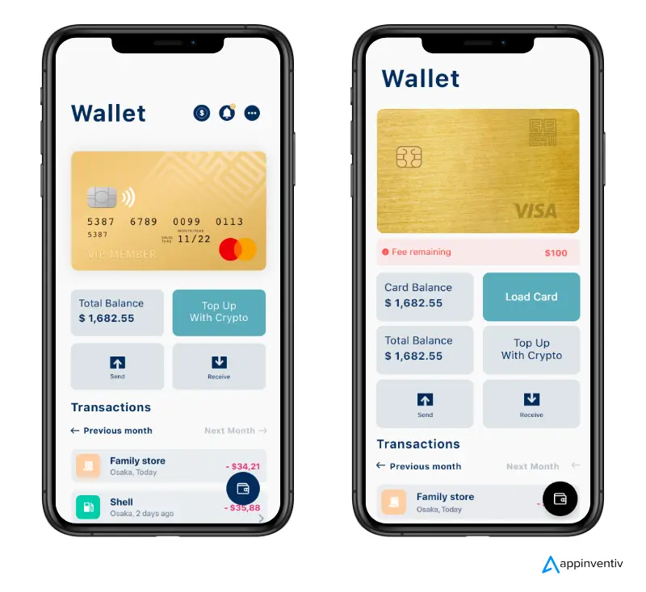
Introduction
Creating complex applications like an mobile banking app requires coordinated planning and collaboration across multiple teams.

Slide 4
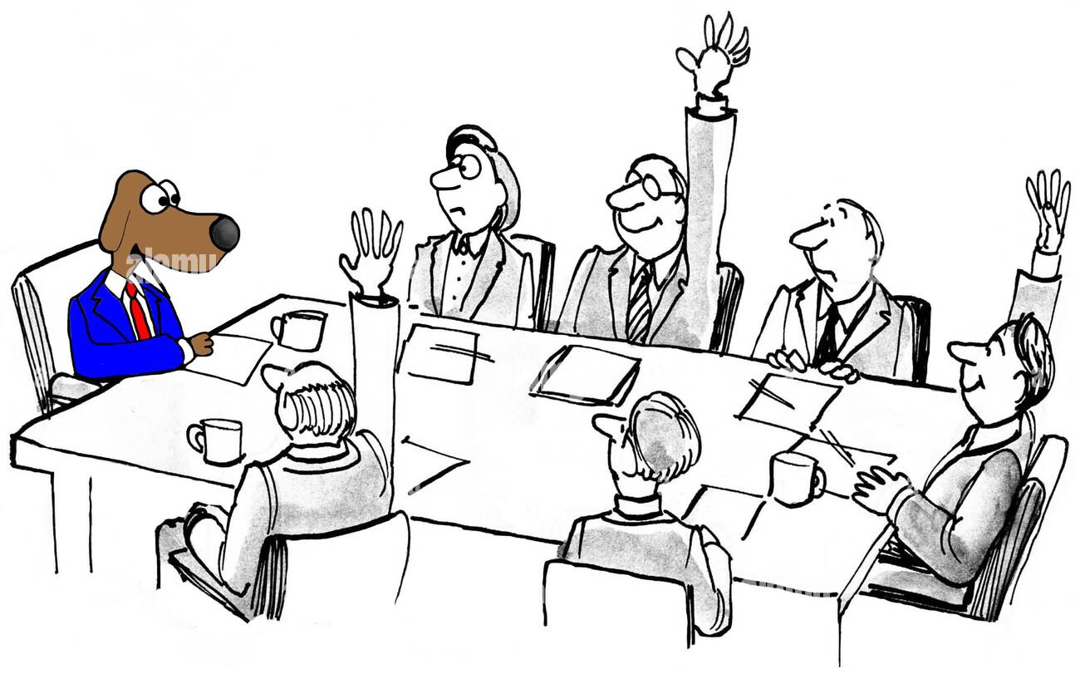
Introduction
It is not just the developers who are involved.
Management, product, and other teams also play essential roles in creating any system.

Slide 5
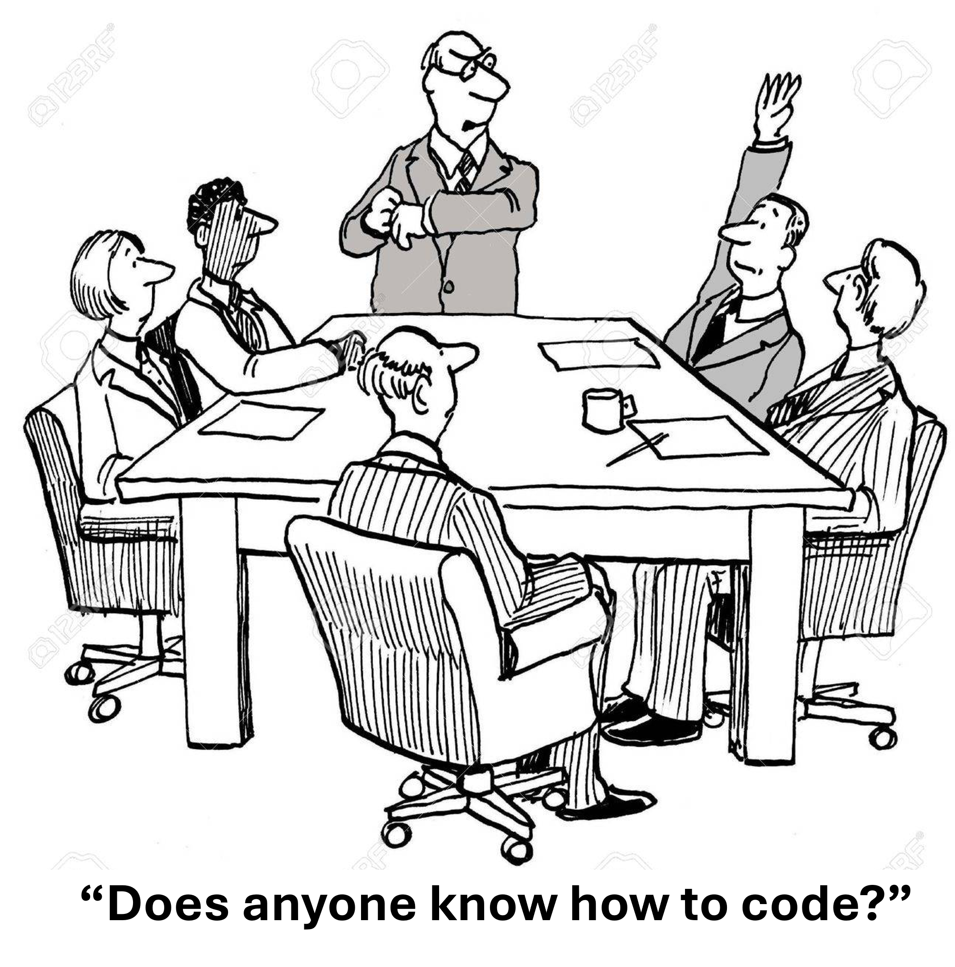
Introduction
However, most business professionals often do not understand code.
Since not everyone cannot read and let alone write code…

Slide 6
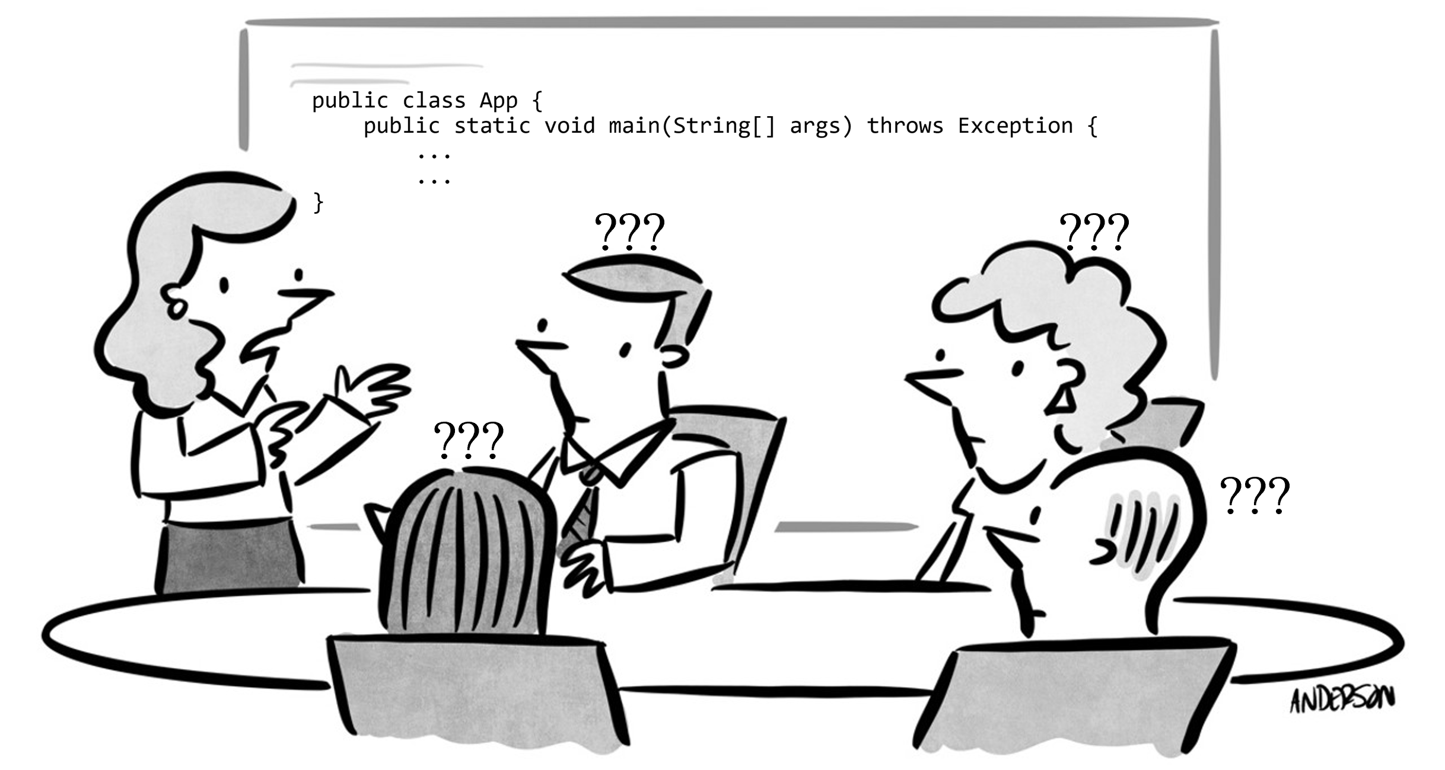
Introduction
We cannot just present code in a board to explain every detail of how everything works in the system.

Slide 7

Introduction
Or teach them on the spot.
Hence, there is a need for a clear and concise way to communicate effectively among themselves.

Slide 8
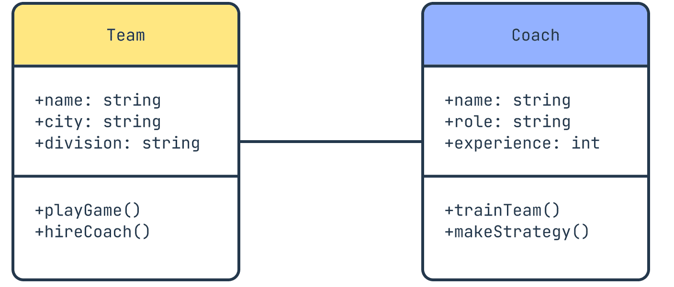
Unified Modeling Language (UML)
That’s why Unified Modeling Language (UML) was created to forge a common visual language in the complex world of software development that would also be understandable for business users and anyone who wants to understand a system.

Slide 9
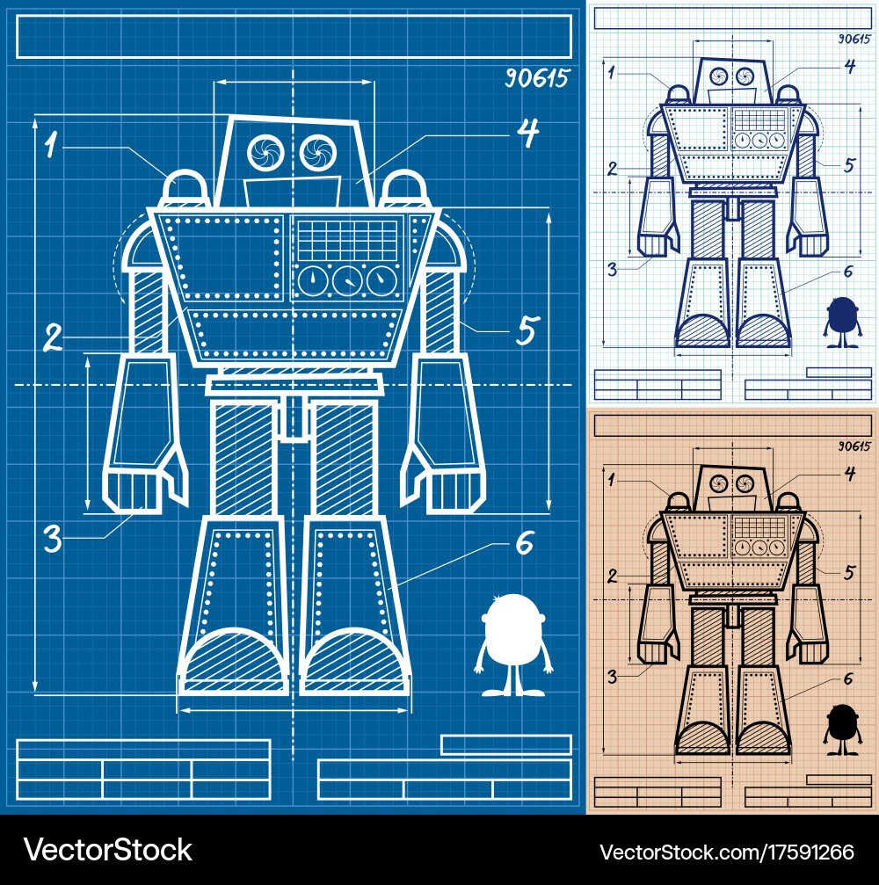
Unified Modeling Language (UML)
It is similar to the blueprints used in other fields, and consists of different types of diagrams.
In the aggregate, UML diagrams describe the boundary, structure, and the behavior of the system and the objects within it.

Slide 10
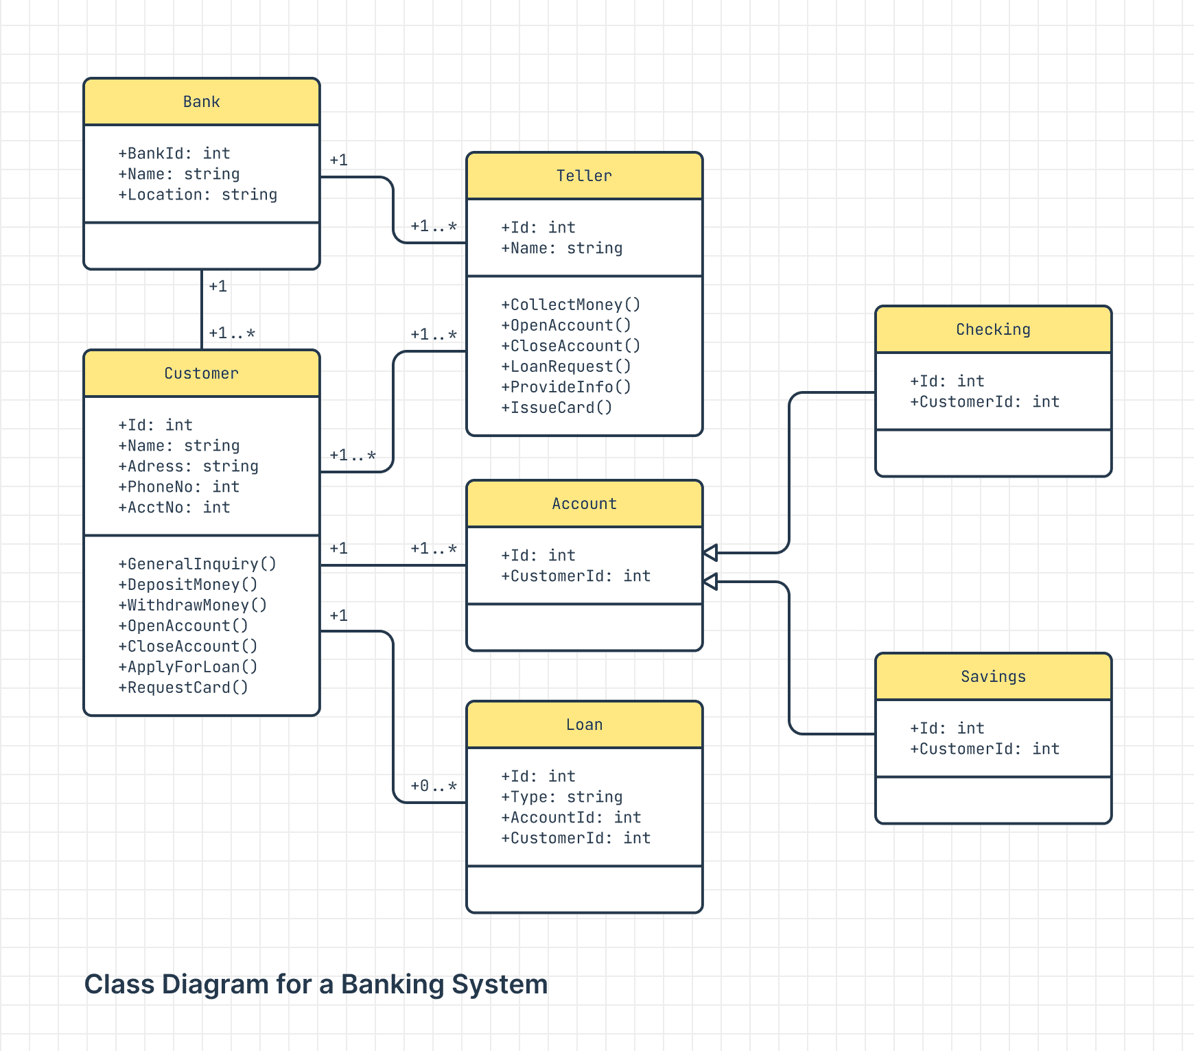
Here is an example of a banking system UML!

Slide 11
UML describes the classes/objects that are in a banking system

Slide 12
And their attributes and behaviours

Slide 13

Unified Modeling Language (UML)
With UML, software developers could now read and disseminate system structure and design plans to other teams, just as construction workers have been doing for years with blueprints of buildings.

Slide 14
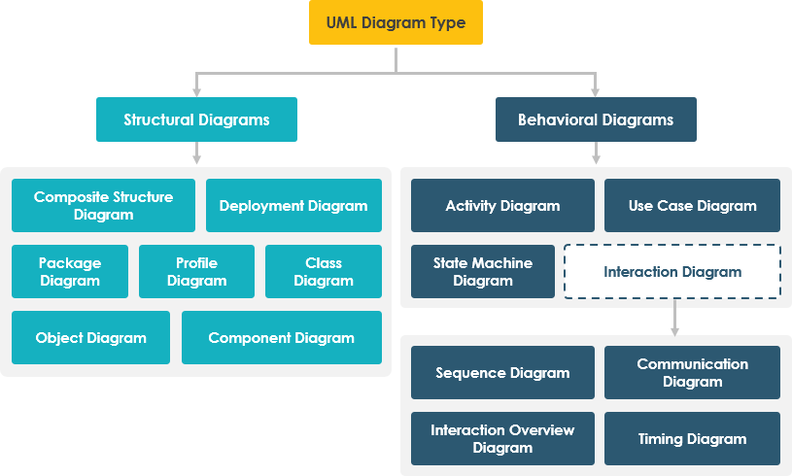
Types of UML

Slide 15
Types of UML
there are two basic categories of diagrams: structure diagrams and behavior diagrams.

Slide 16
Types of UML
The purpose of structure diagrams is to show the static structure of the system being modeled.
They include the class, component, and or object diagrams

Slide 17
Types of UML
Behavioral diagrams, on the other hand, show the dynamic behavior between the objects in the system, including things like their methods, collaborations, and activities

Slide 18
Class Diagram
Class diagrams are one of the most useful types of diagrams in UML as they clearly map out the structure of a particular system by modeling its classes, attributes, operations, and relationships between objects.
Popular among software engineers to document software architecture, class diagrams are a type of structure diagram because they describe what must be present in the system being modeled

Slide 19
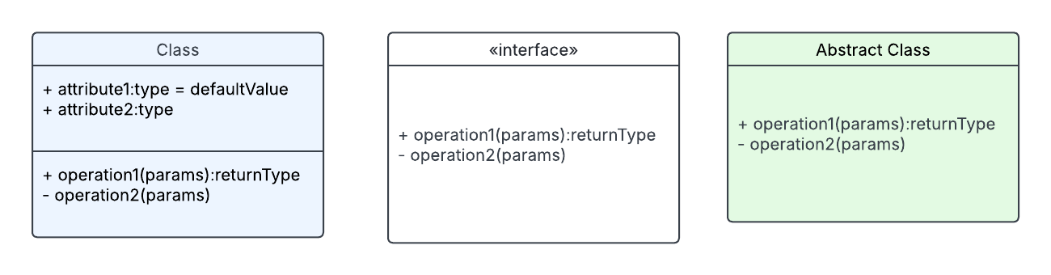
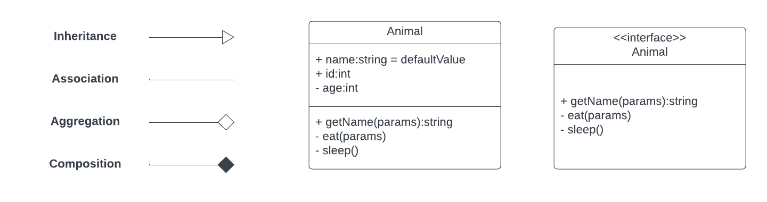
Components of a Class Diagram

Slide 20
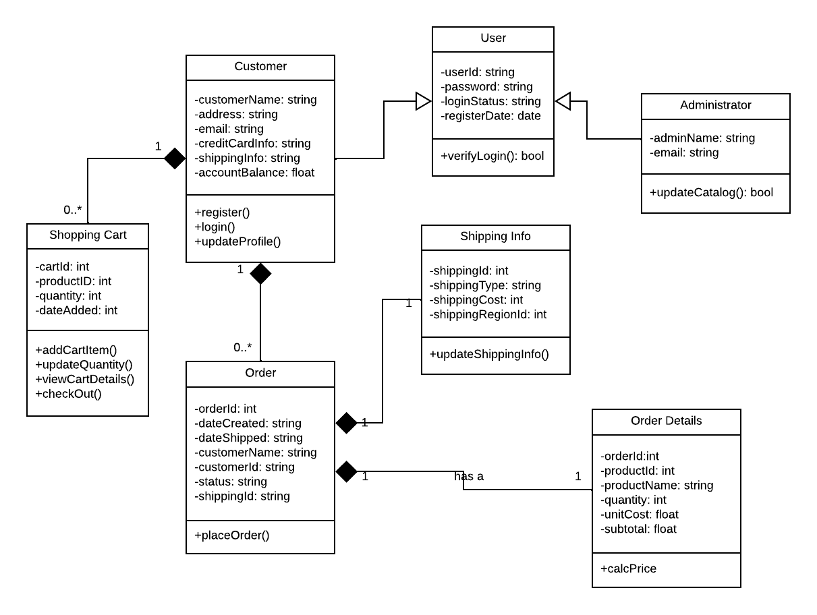
Components of a Class Diagram
Upper Section: Contains the name f the class. This section is always required, whether you are talking about the classifier or an object.

Slide 21
Components of a Class Diagram
Middle Section: Contains the attributes of the class.

Slide 22
Components of a Class Diagram
Bottom Section: Includes class methods. Displayed in list format, each operation takes up its own line. The operations describe how a class interacts with data.

Slide 23
Member access modifiers
All classes have different access levels depending on the access modifier (visibility).
Public (+)
Private (-)
Protected (#)

Slide 24
Relationships Between Classes

Slide 25
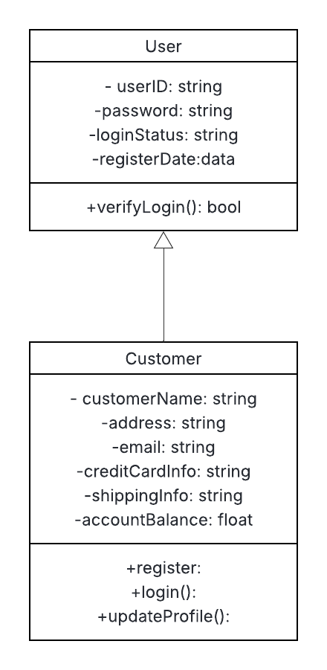
Inheritance
In UML, inheritance is symbolized with a straight connected line with a closed arrowhead pointing towards the parent class.

Slide 26
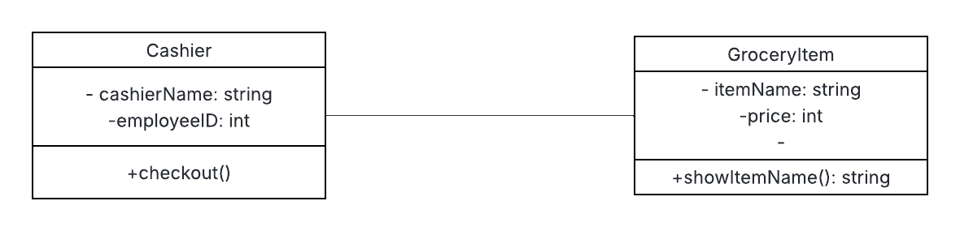
Association
Association is a type of relationship in which one object uses or interacts with another.

Slide 27
Association
It represents a general relationship between two different classes where they interact with each other.

Slide 28
Association
In this example, Cashier checks out a GroceryItem which are both independent of each other.

Slide 29
Association
In UML, association is symbolized with a straight connected line pointing towards another class

Slide 30
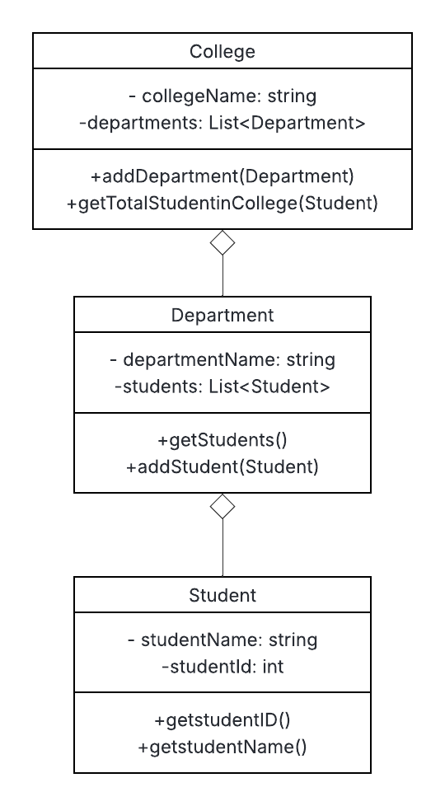
Aggregation
Aggregation is a type of association that represents a relationship where one class is a collection or container of another class.

Slide 31
Aggregation
It represents a “has-a” relationship, where in each class have independent existence and they are not tied to each other.

Slide 32
College has a number of departments like CS and IT.

Slide 33
Every department has a number of students.

Slide 34
The College, Department and Student classes can exist on their own

Slide 35
Aggregation
In UML, aggregation is symbolized with a straight line connected with a white diamond at the end pointing towards another class

Slide 36
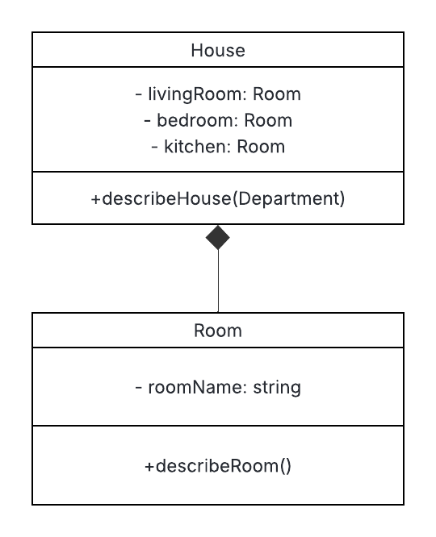
Composition
Composition is a restricted form of aggregation in which two entities are highly dependent on each other.
When there is a composition between two entities, the composed object cannot exist without the other entity.

Slide 37
Composition
It represents a “part-of” relationship where one class contains an object of another class, and the contained object cannot exist independently of the container object.

Slide 38
Composition
In UML, composition is symbolized with a straight line connected with a black diamond at the end pointing towards another class

Slide 39
For example, a Room is part of a House

Slide 40
If the House is destroyed, the Room cannot exist on its own.

Slide 41
Both House and Room are dependent on each other.

Slide 42
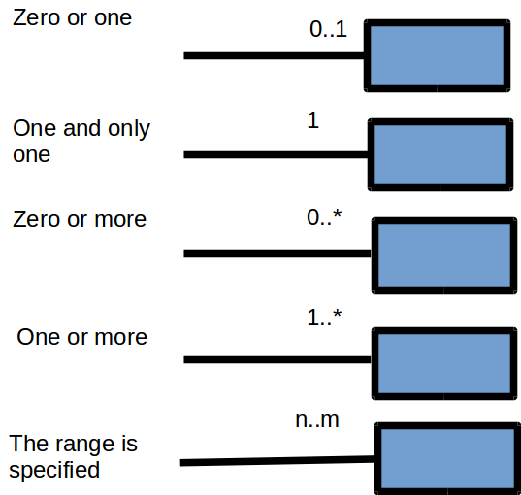
Cardinality
Cardinality indicates the number of instances of one class linked to the instances of another class.
This can be simply expressed as a one to one, one to many or many to many relationship

Slide 44
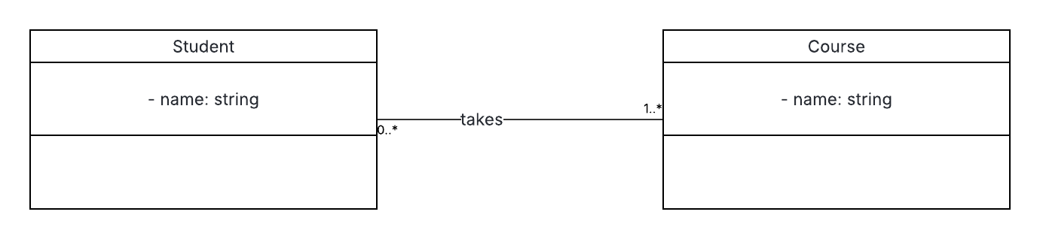
Let’s say we have two classes as ‘Student and Course’.

Slide 45
A student should do one or more courses

Slide 46
While a course may have zero or more students. We can indicate this scenario as follows.

Slide 48
A Customer can have zero or more Shopping Cart
While a Shopping Cart can only be owned by one and only one Customer

Slide 49
A Customer can have zero or more Order
While an Order can only be owned by one and only one Customer.

Slide 50
An Order can only have one and only one Shipping Info
While a Shipping Info can only associated by one and only one Order.

Slide 51
An Order can only have one and only one Order Details
While an Order Details
can only associated by one and only one Order.

Slide 52
References
https://developer.ibm.com/articles/the-class-diagram/
https://www.lucidchart.com/pages/uml-class-diagram

